Slide 1
Identifying Neighborhood to open a restaurant
In which neighborhood in North York a restaurant can be opened

Slide 2
.
To suggest her the best neighborhood, below are the few things that I considered along with competition.
Accessibility If restaurant near residential or student living places, it provides better commute.
Visibility If it is in a place where there are few other restaurants, shopping malls, grocery stores it gives more visibility
Crime rate High crime rates can make potential customers uncomfortable. Therefore if restaurant is in a busy neighborhood surrounded by few other malls or restaurants, less crime rate more customers.

Slide 3
.
DATA COLLECTING AND CLEANING:
latitude and longitude numbers of that borough(43.7708175, -79.4132998)
data about different venues in different neighborhoods of that specific borough. In order to gain that information I will use "Foursquare" locational information. (52 venues were returned by Foursquare)

Slide 4
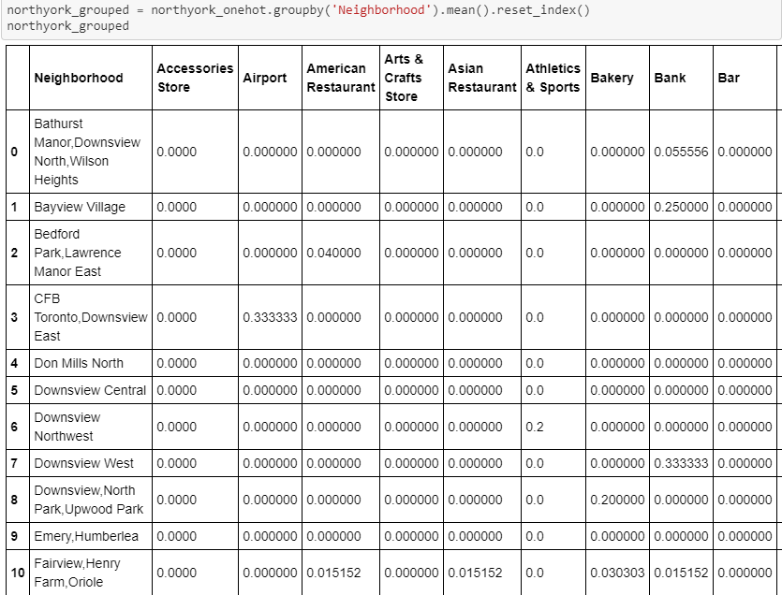
.
Onehot encoding.

Slide 5
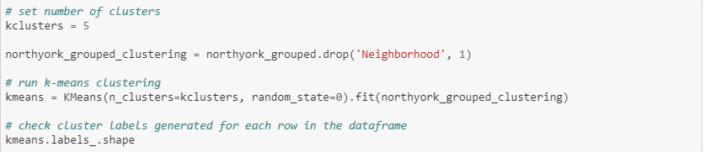
.
Applying one of Machine Learning Techniques (K-Means Clustering)
Here we cluster neighborhoods via K-means clustering method. We think that 5 clusters is enough and can cover the complexity of our problem. After clustering we will update our dataset and create a column representing the group for each neighborhood.

Slide 6
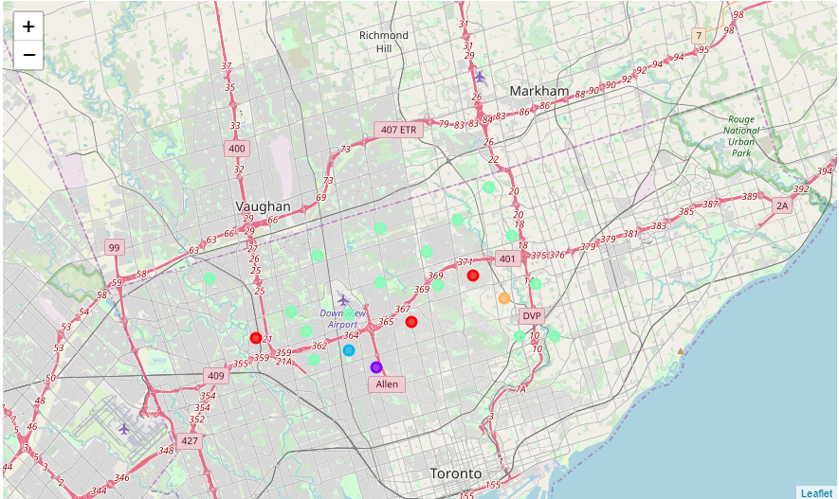
.

Slide 7
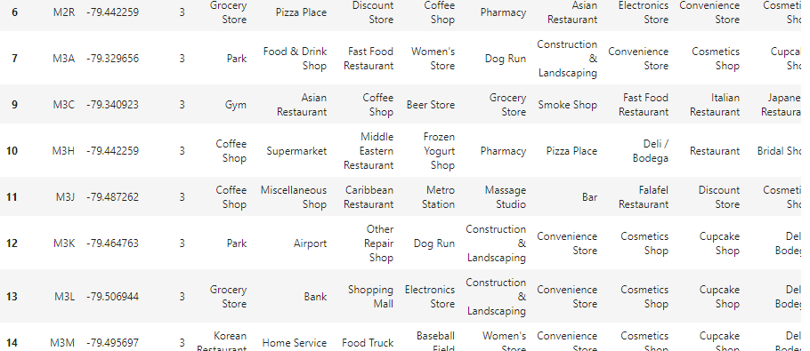
Results: Here for North York, I have used 5 clusters(k=5 ie 0,1,2,3,4). If we look at k=3 cluster, M3A zip code has park, decent restaurants and also shopping stores. It satisfies few of above mentioned criteria like accessibility, visibility and less crime rate. This algorithm although is pretty straightforward yet is strongly powerful. Results: Based on this analysis, the best recommended neighborhood will be: 'Neighborhood': 'Parkwoods', 'Postal Code': 'M3A', 'Neighborhood Latitude': 43.753259, 'Neighborhood Longitude': -79.329656

